Slide 1
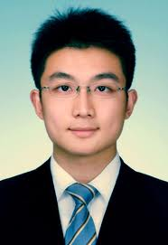
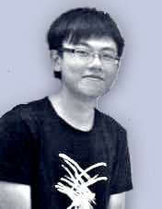

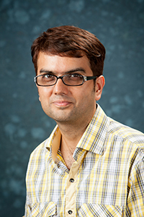

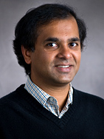


Fast and robust sparse recovery
New Algorithms and Applications
Mayank Bakshi
INC, CUHK
Sheng
Cai
Eric
Chan
Mohammad
Jahangoshahi
Sidharth
Jaggi
Venkatesh
Saligrama
Minghua
Chen
The Chinese University
of Hong Kong
The Institute of
Network Coding

Slide 2
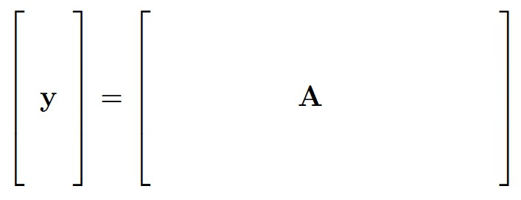
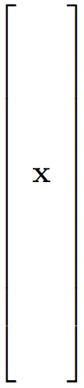

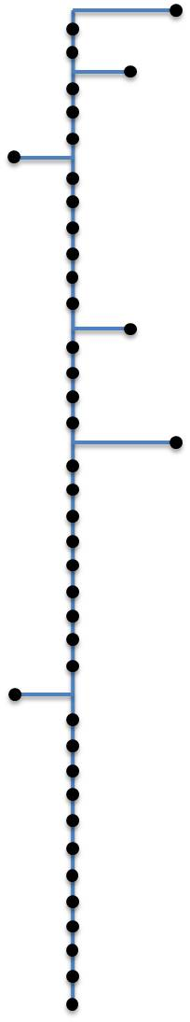

Fast and robust sparse recovery
m
?
n
Measurement
Measurement output
k
m<n
Reconstruct x
Unknown x

Slide 3
Fast and robust sparse recovery
m
?
n
m<n

Slide 4


A. Compressive sensing
?
m
?
n
k
k ≤ m<n

Slide 5
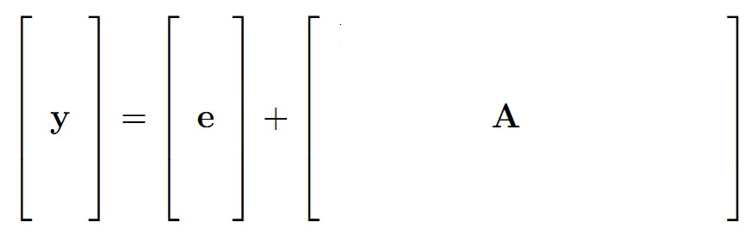
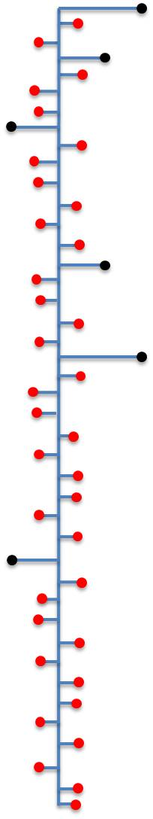
A. Robust compressive sensing
?
e
z
y=A(x+z)+e
Approximate sparsity
Measurement noise

Slide 6
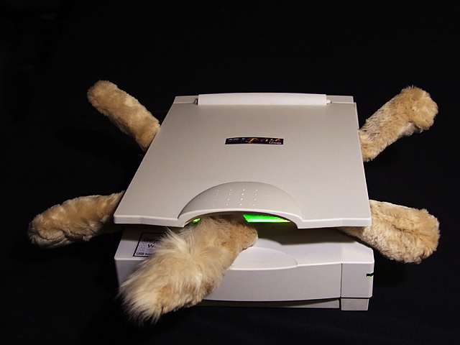
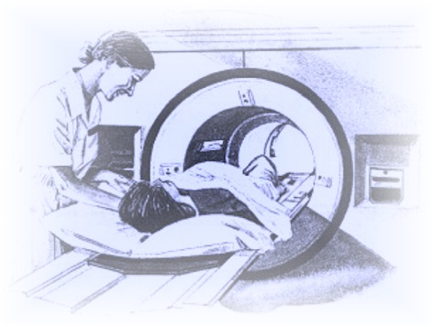
Tomography
Computerized Axial
(CAT scan)

Slide 7
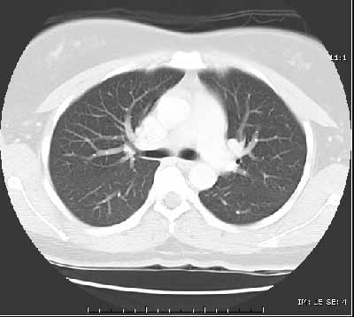
B. Tomography
y = Tx
Estimate x given y and T

Slide 8
B. Network Tomography
Transform T:
  Network connectivity matrix (known a priori)
Measurements y:
  End-to-end packet delays
Infer x:
  Link/node congestion
Hopefully “k-sparse”
Compressive sensing?
Challenge:
  Matrix T “fixed”
  Can only take “some”
  types of measurements

Slide 9

C. Robust group testing
n-d
q
d
1
0
q
0
1
For Pr(error)< ε , Lower bound:
What’s known
…[CCJS11]
Noisy Combinatorial OMP:
Notes:
Malioutov only analyze noiseless case and assume M to be disjunct

Slide 10


Slide 11
A. Robust compressive sensing
?
e
z
y=A(x+z)+e
Approximate sparsity
Measurement noise

Slide 12
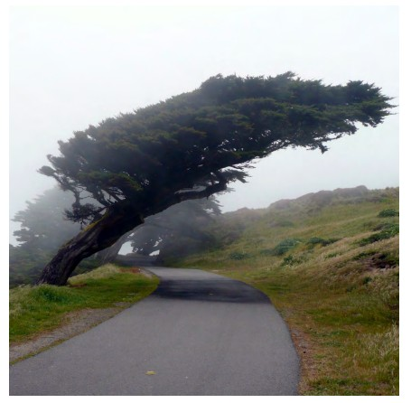
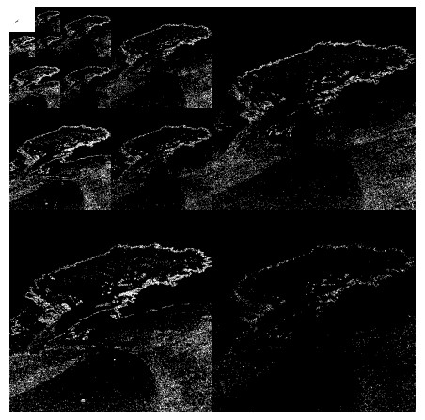
Apps: 1. Compression
W(x+z)
x+z
BW(x+z)
= A(x+z)
M.A. Davenport, M.F. Duarte, Y.C. Eldar, and G. Kutyniok, "Introduction to Compressed Sensing,"in Compressed Sensing: Theory and Applications, 2012

Slide 13
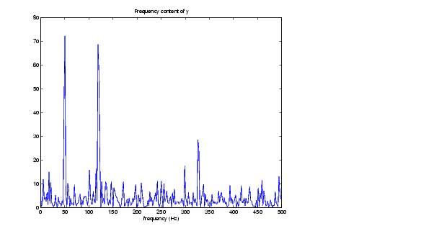
Apps: 2. Fast(er) Fourier Transform
H. Hassanieh, P. Indyk, D. Katabi, and E. Price. Nearly optimal sparse fourier transform. In Proceedings of the 44th symposium on Theory of Computing (STOC '12).

Slide 14
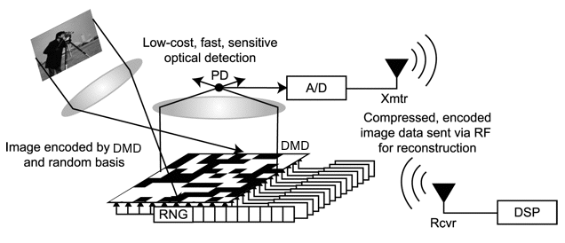
Apps: 3. One-pixel camera
http://dsp.rice.edu/sites/dsp.rice.edu/files/cs/cscam.gif

Slide 15
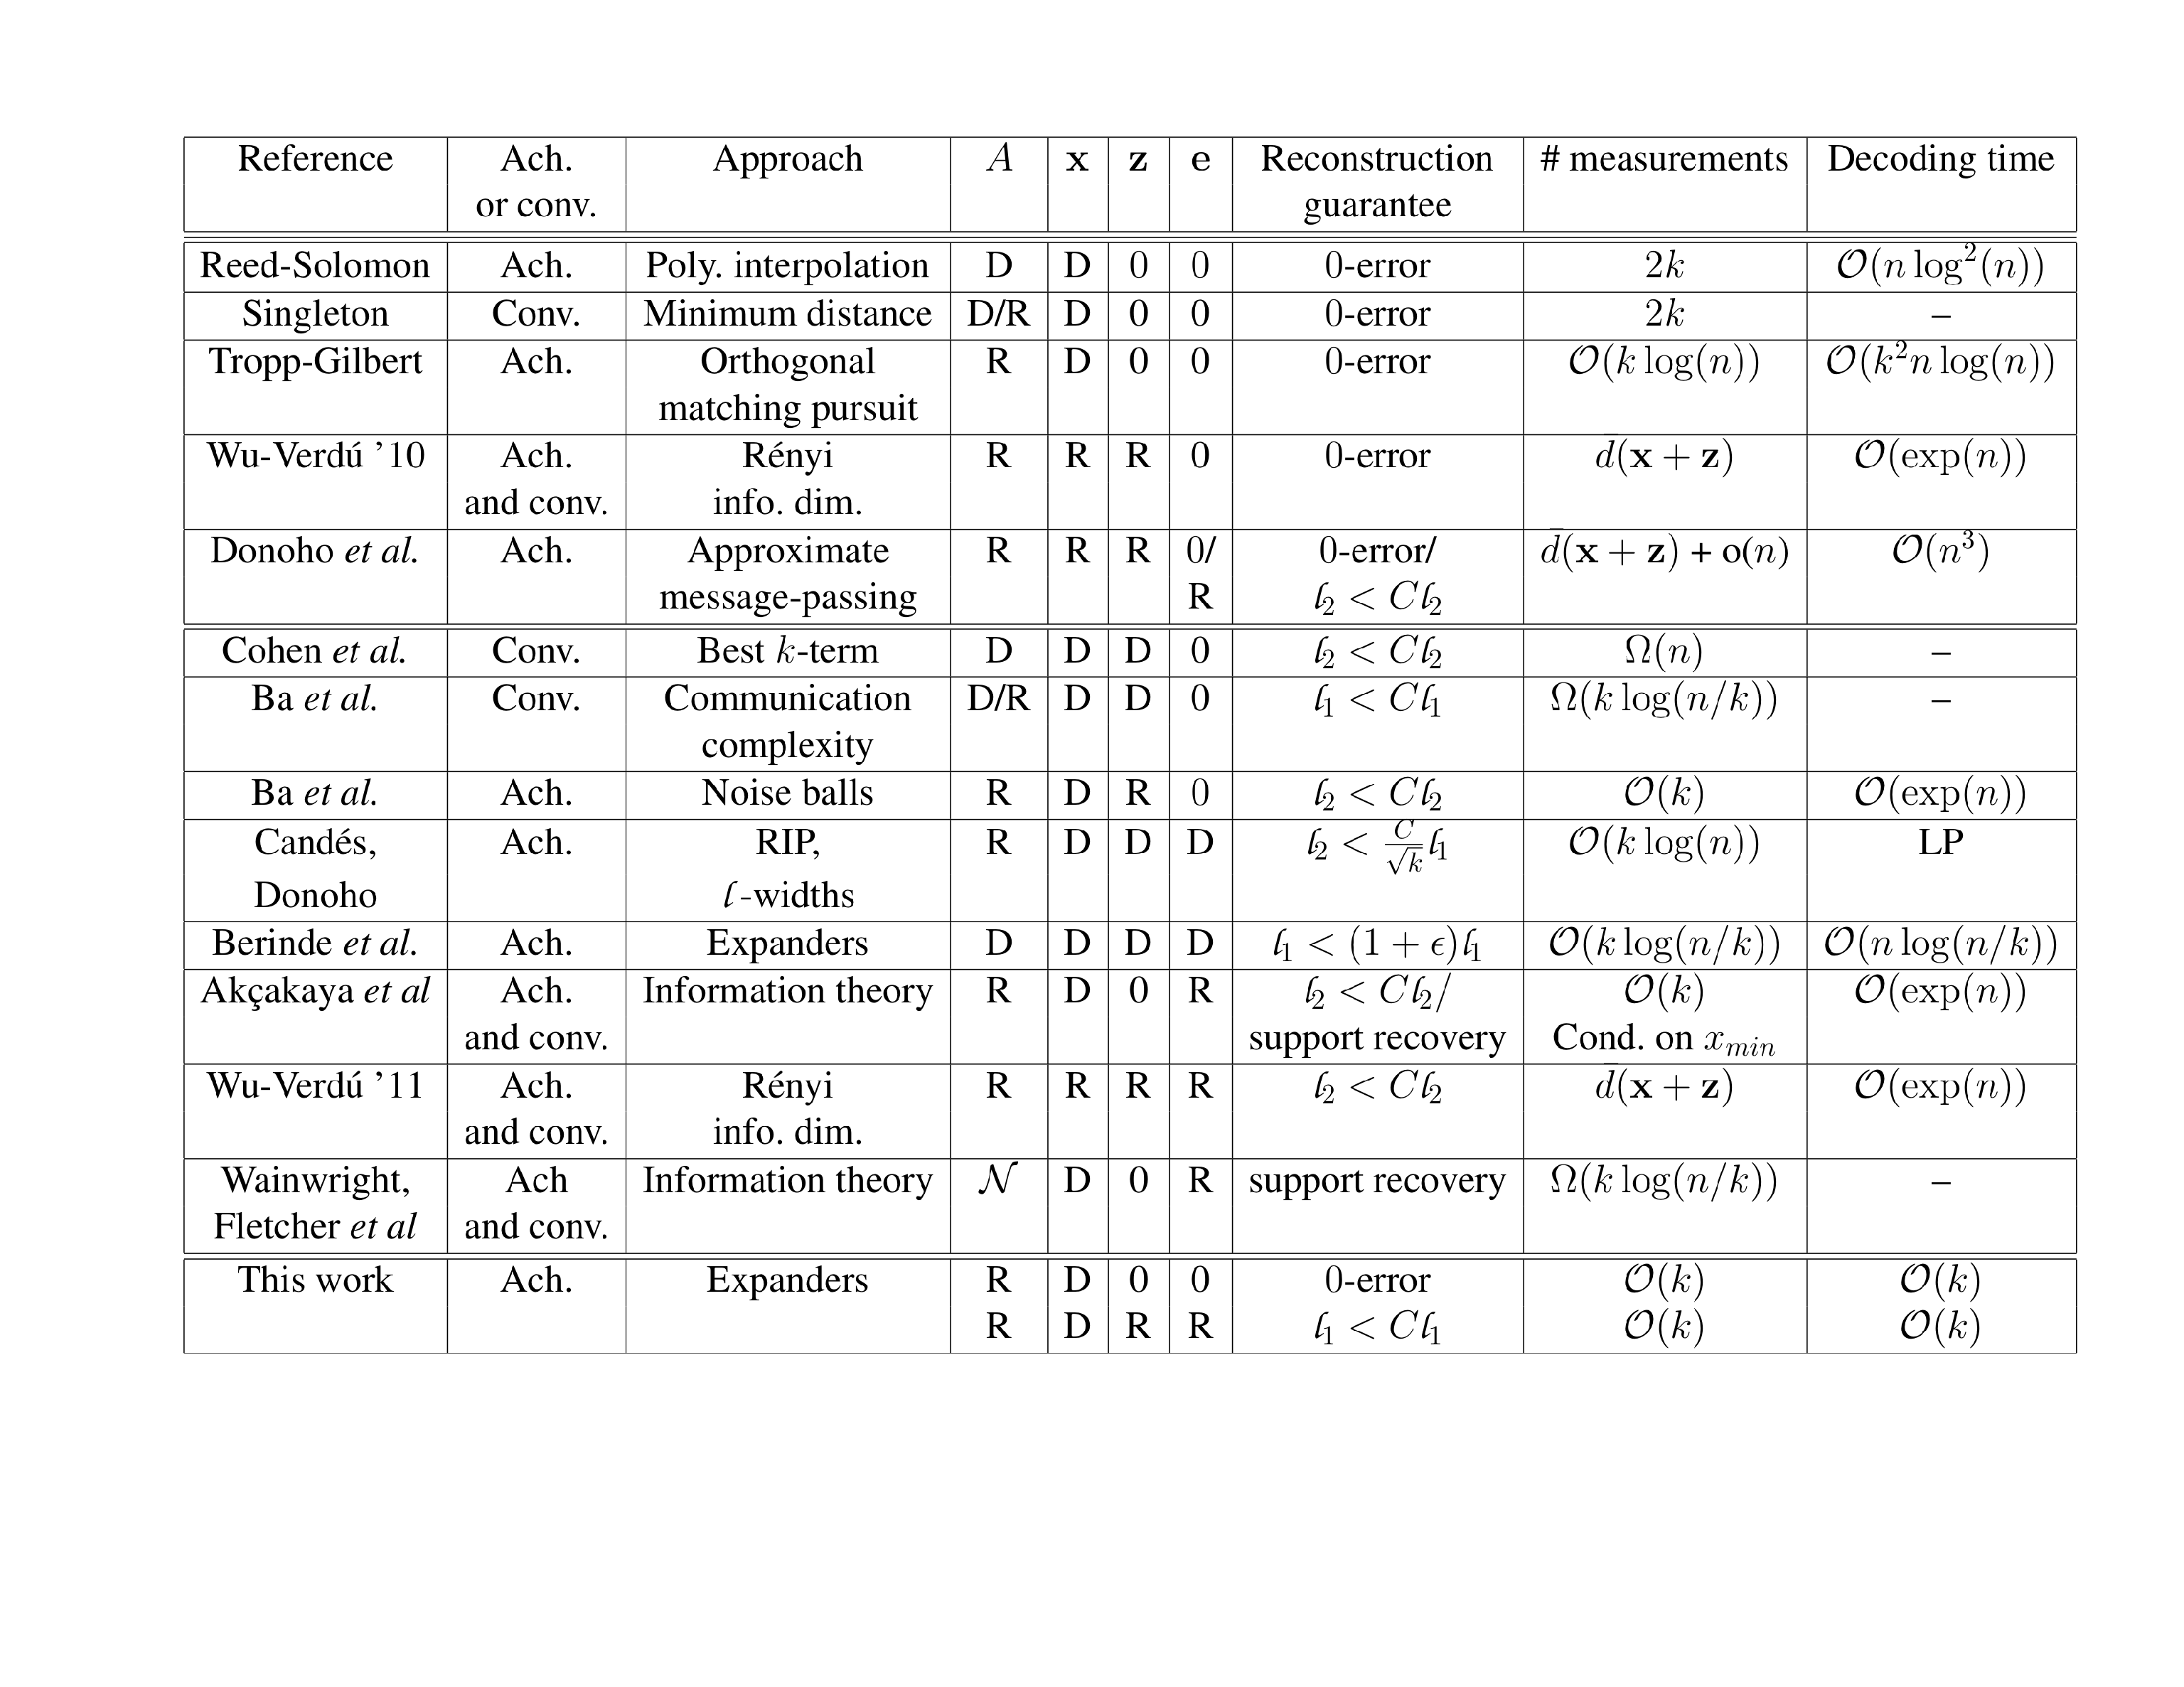

y=A(x+z)+e

Slide 16

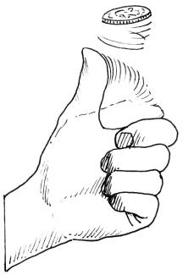
y=A(x+z)+e

Slide 17

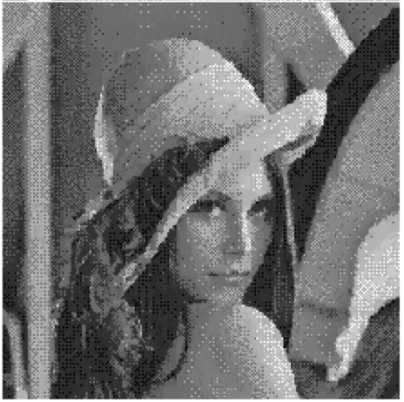
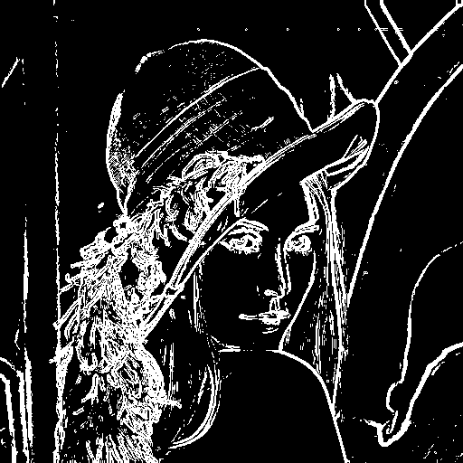
y=A(x+z)+e

Slide 18
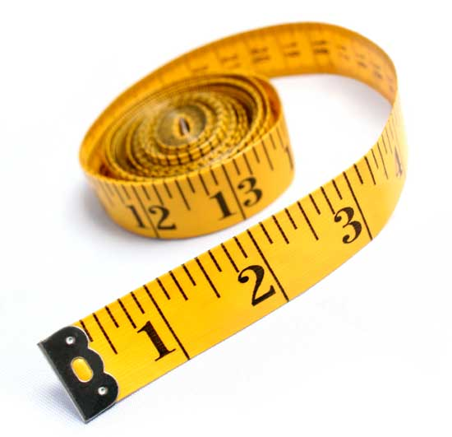

y=A(x+z)+e

Slide 19
y=A(x+z)+e
(Information-theoretically) order-optimal

Slide 20
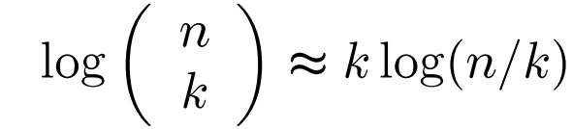
(Information-theoretically) order-optimal
Support Recovery

Slide 21
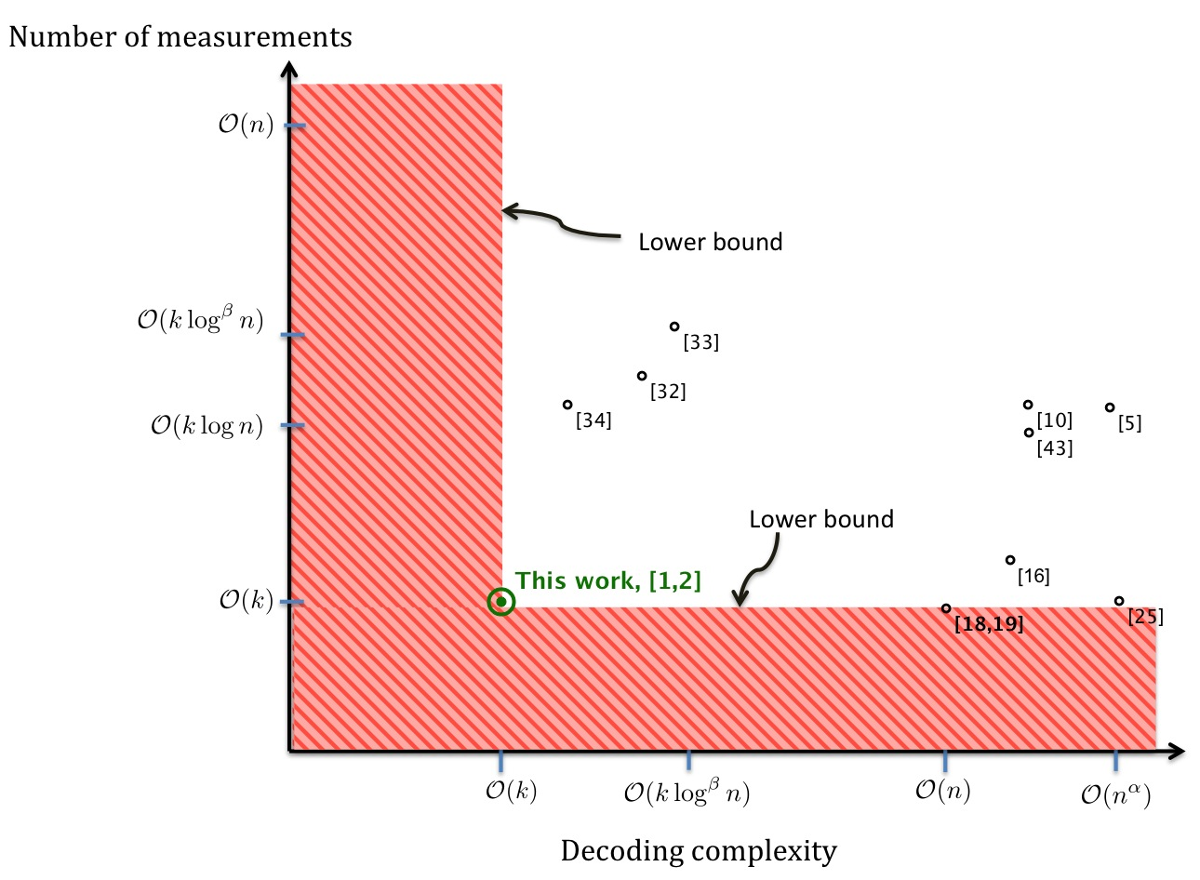
SHO-FA:SHO(rt)-FA(st)

Slide 22
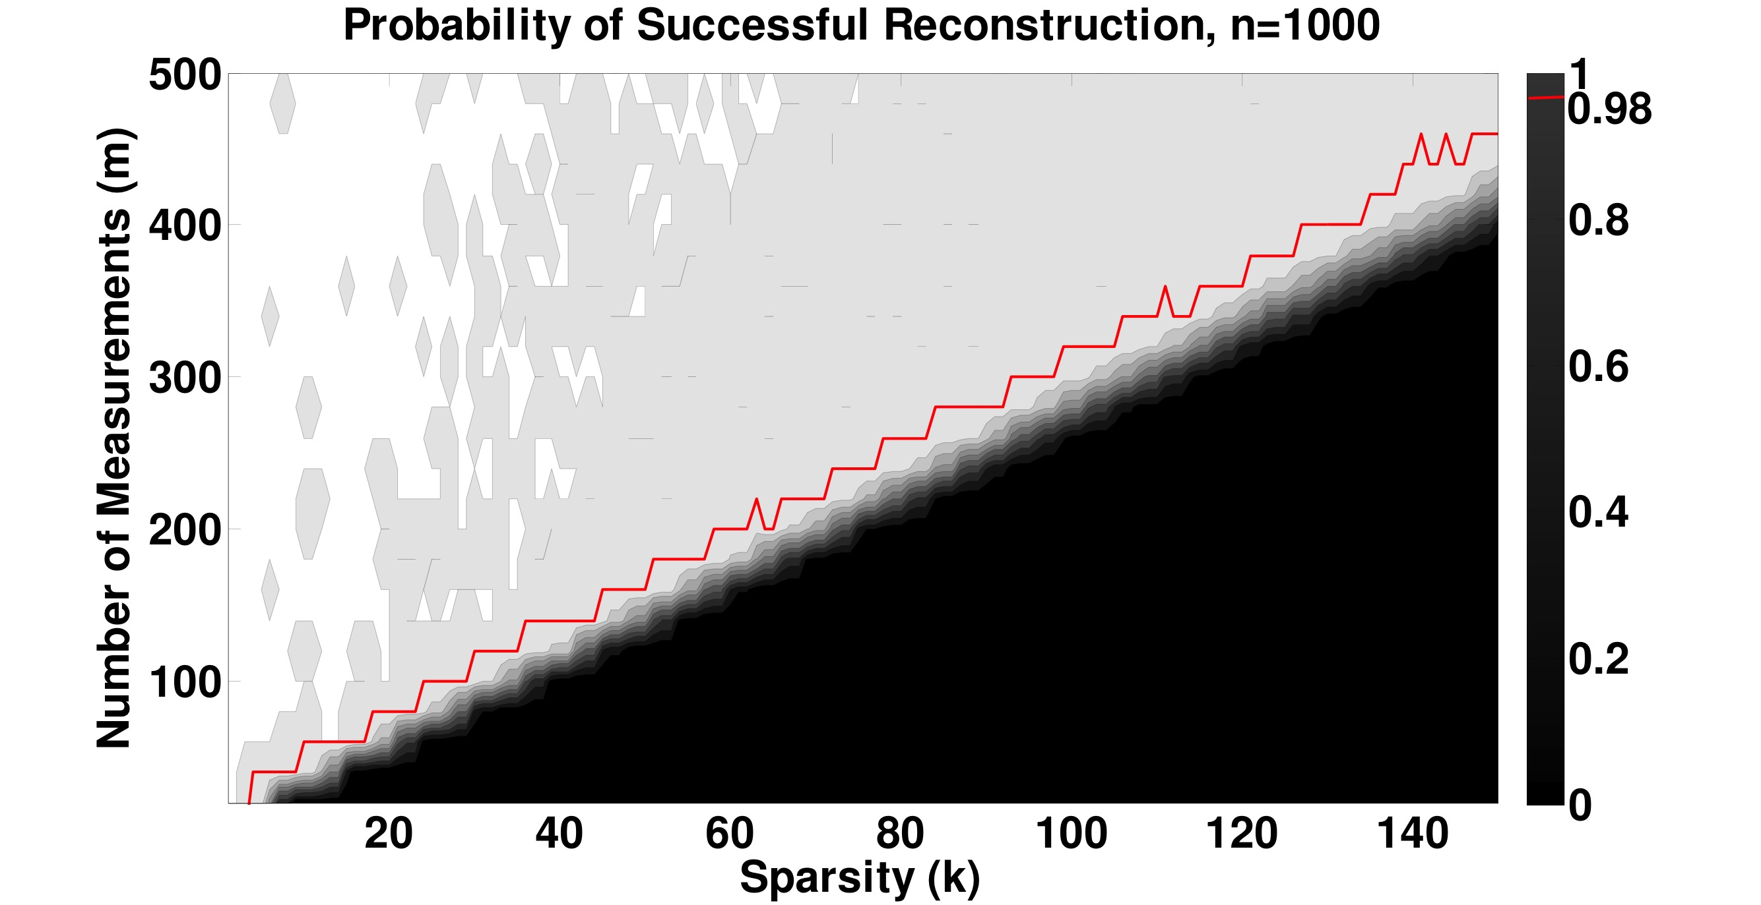
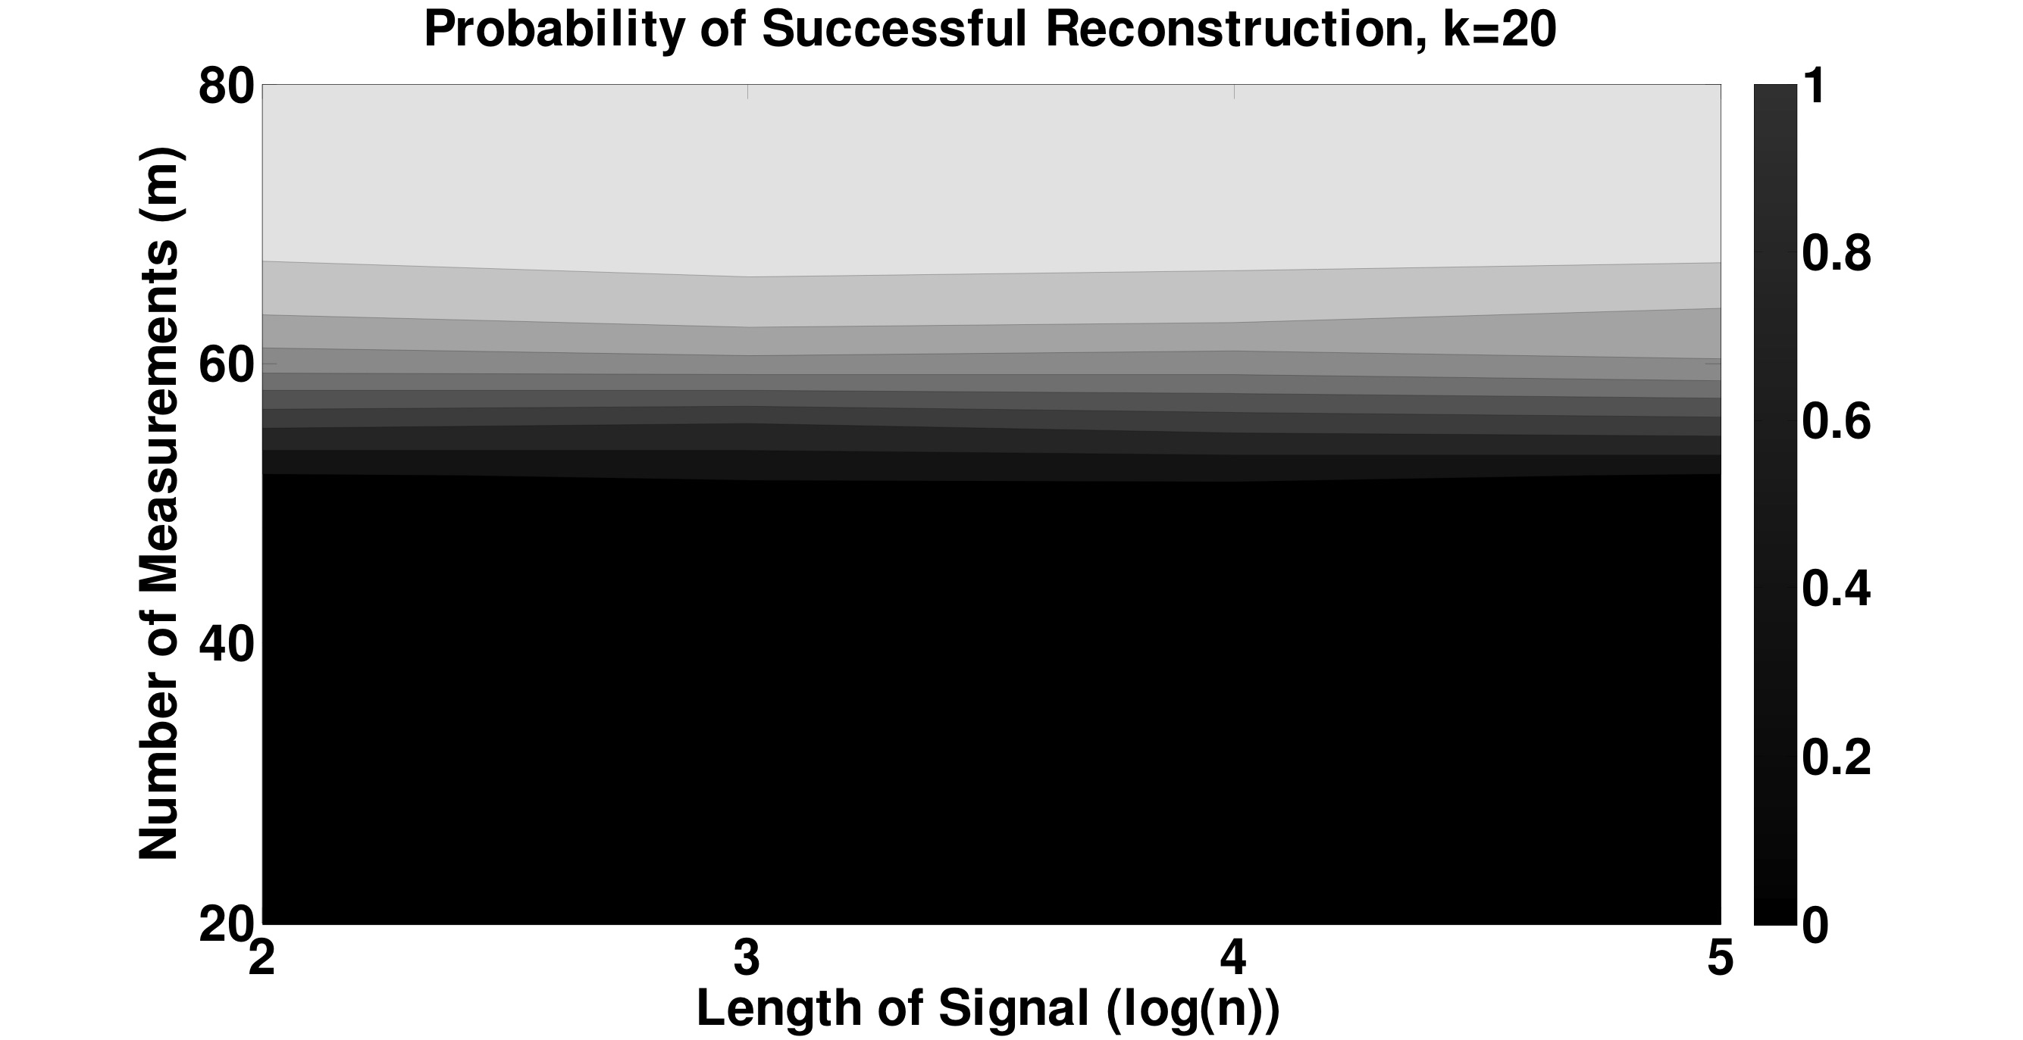
O(k) measurements,
O(k) time

Slide 23

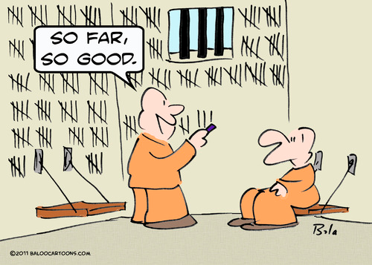
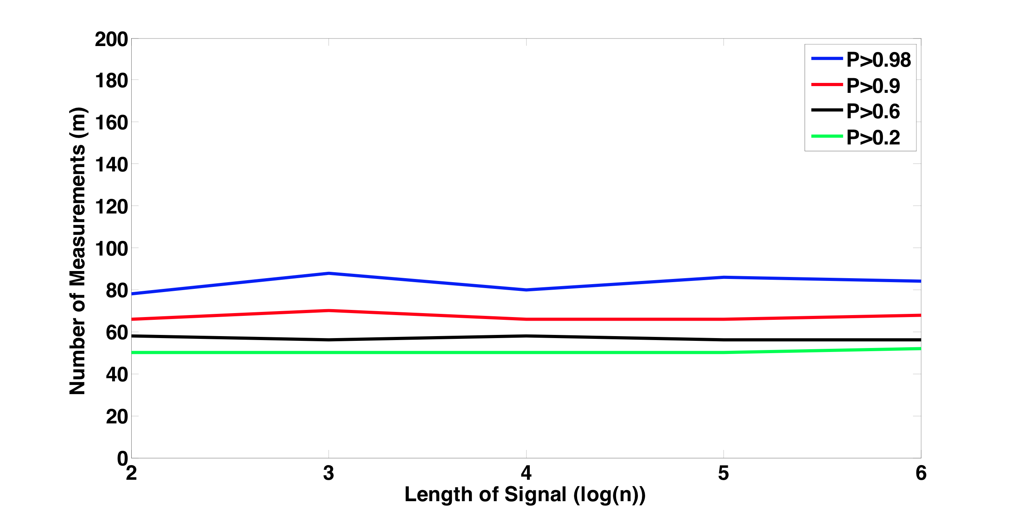
SHO(rt)-FA(st)
O(k) meas., O(k) steps

Slide 24
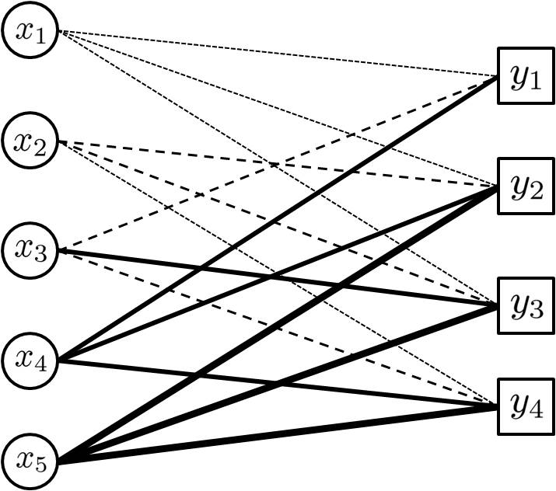
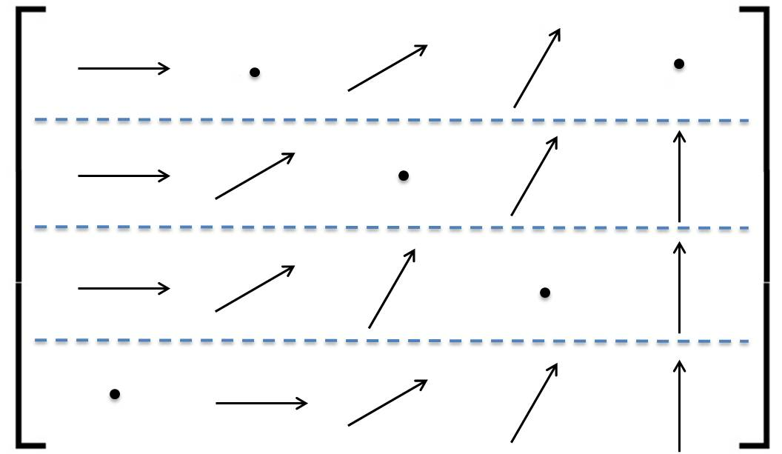
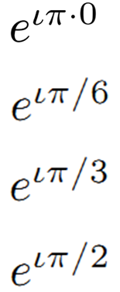

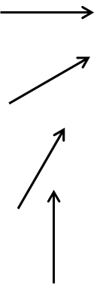
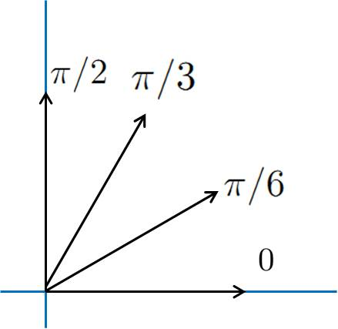
1. Graph-Matrix
d=3
A
n
ck

Slide 25
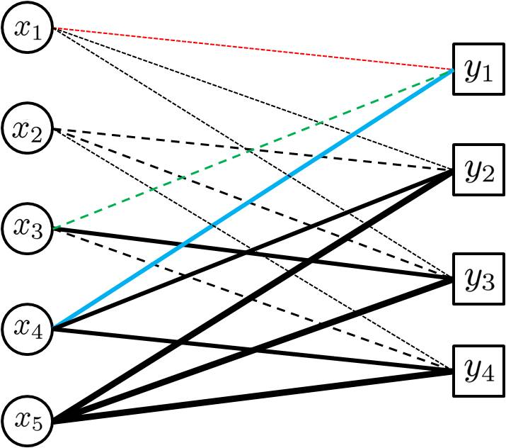
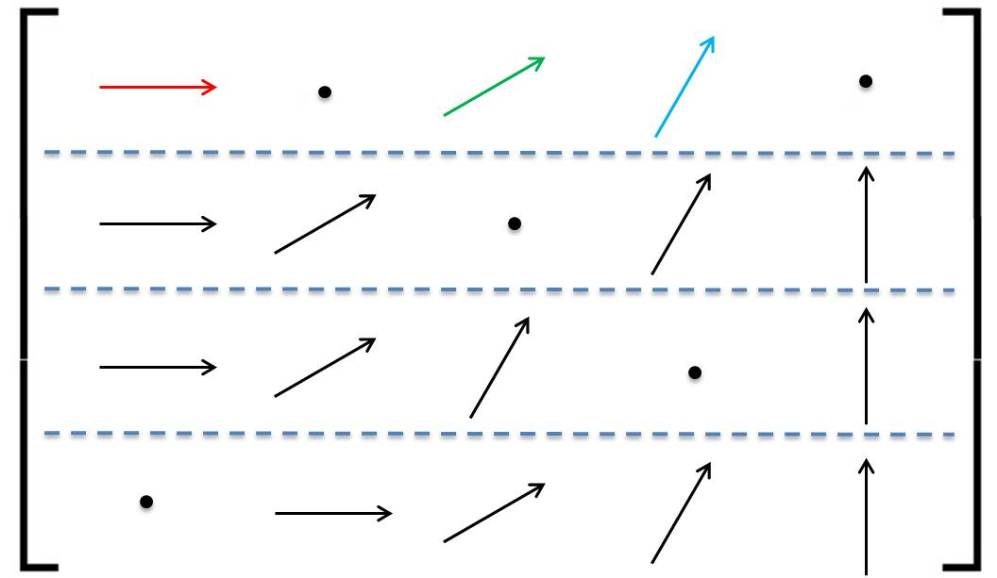
1. Graph-Matrix
d=3
A
n
ck

Slide 26









1. Graph-Matrix

Slide 27
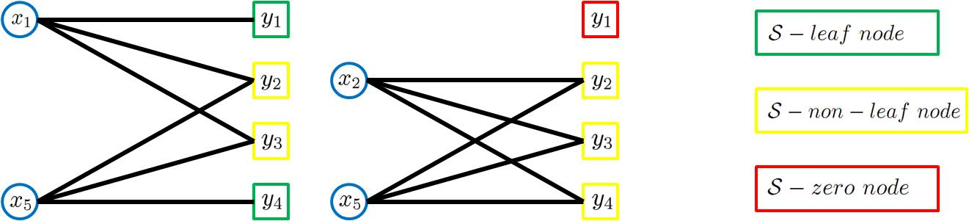

2. (Most) x-expansion
|S|
≥2|S|

Slide 28
3. “Many” leafs
L+L’≥2|S|
|S|
≥2|S|
3|S|≥L+2L’
L≥|S|
L+L’≤3|S|
L/(L+L’) ≥1/2
L/(L+L’) ≥1/3

Slide 29
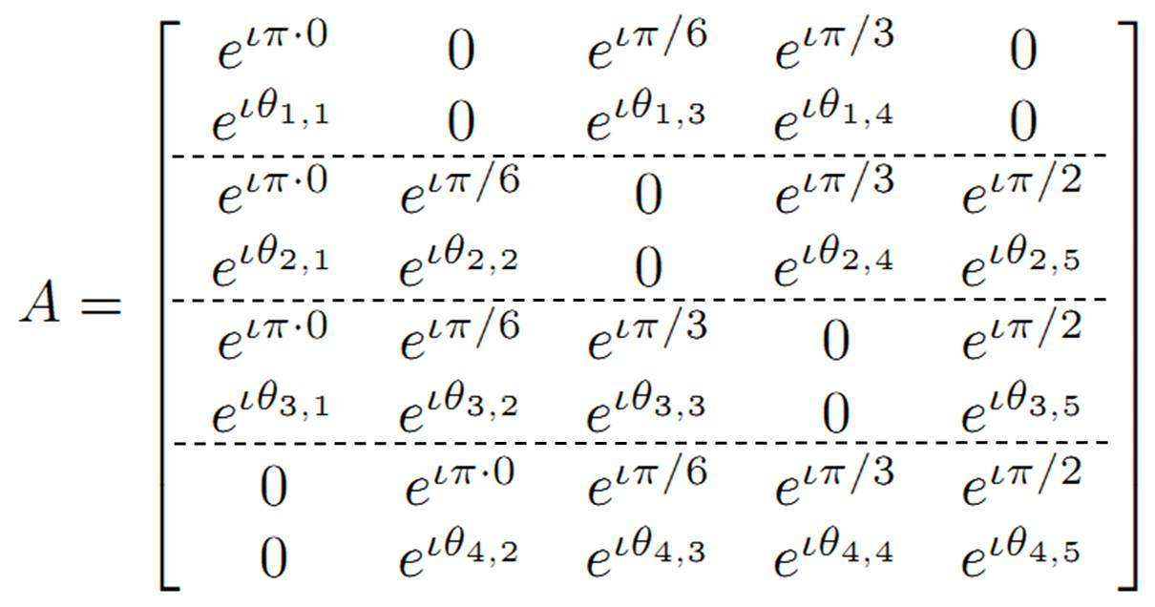
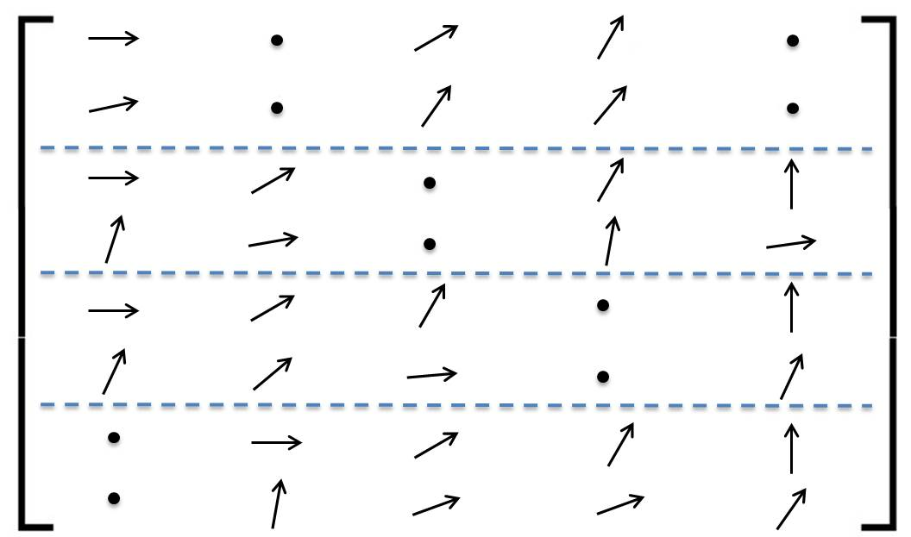


4. Matrix

Slide 30

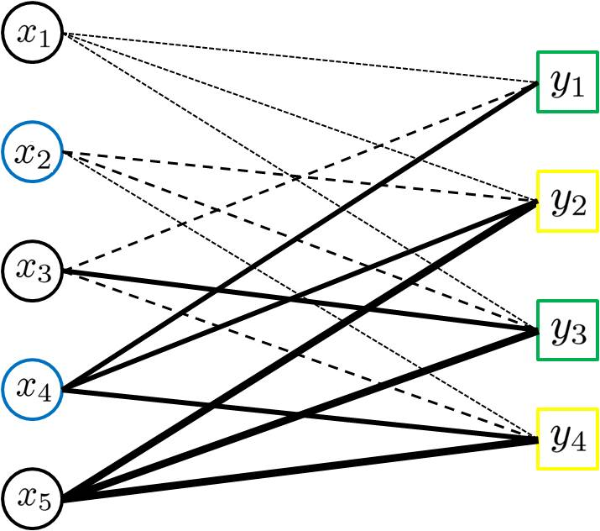
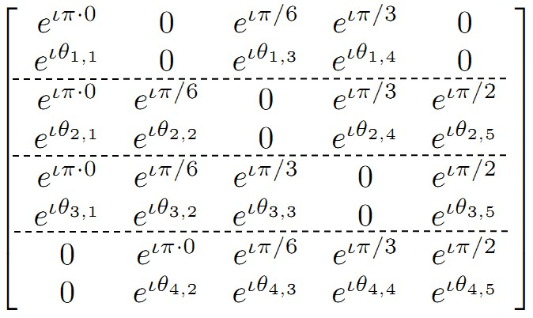
Encoding – Recap.
0
1
0
1
0

Slide 31


Decoding – Initialization

Slide 32
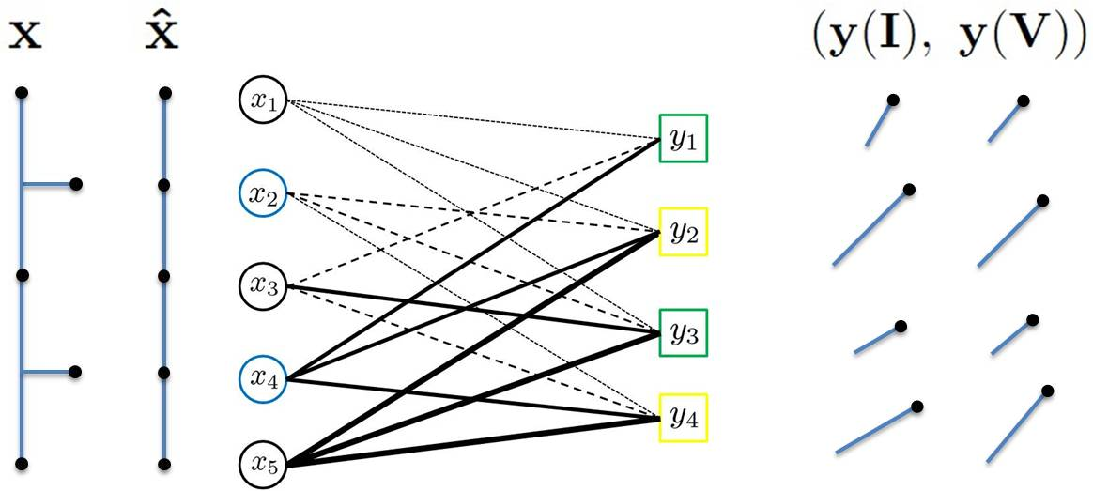

Decoding – Leaf Check(2-Failed-ID)

Slide 33
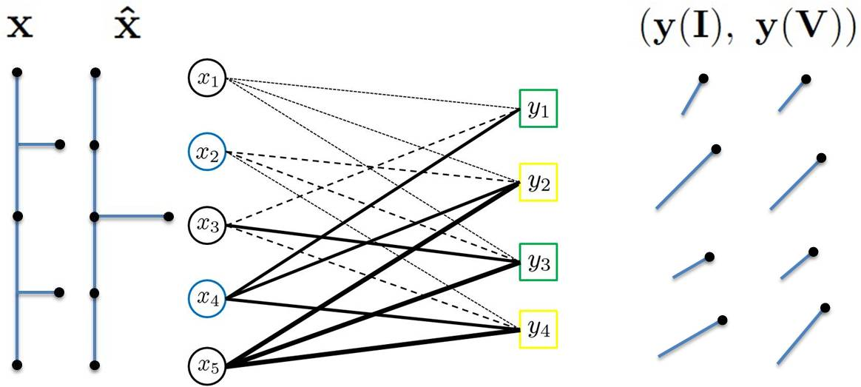


Decoding – Leaf Check (4-Failed-VER)

Slide 34
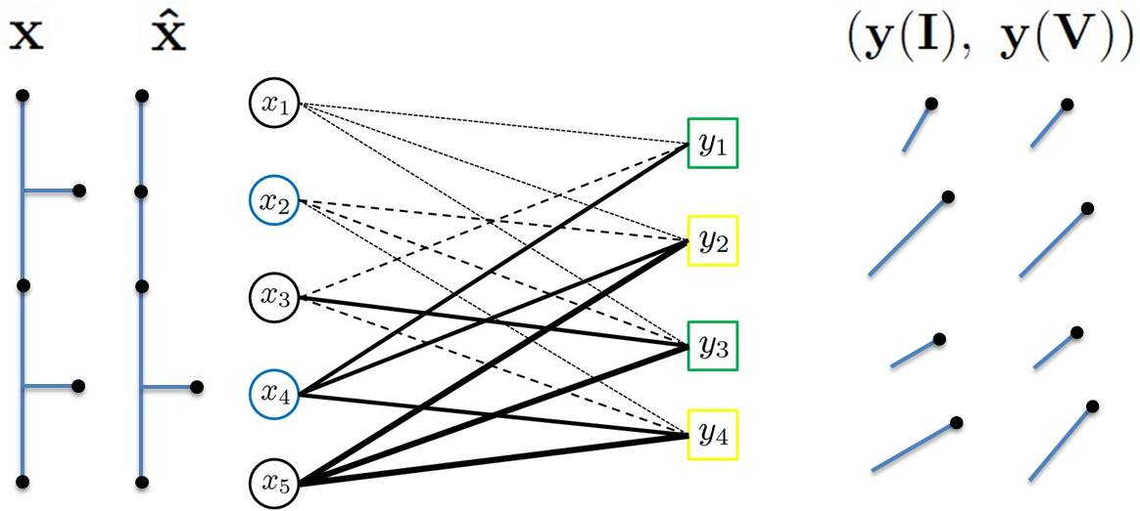

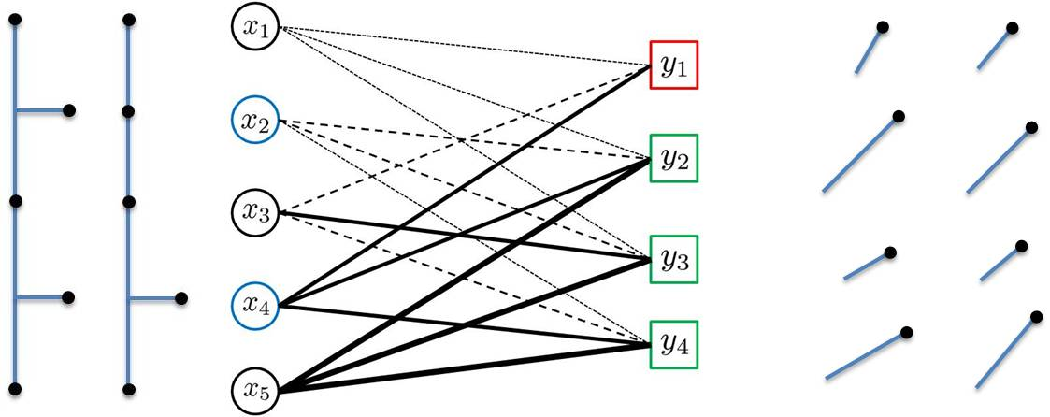
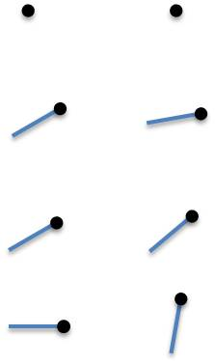

Decoding – Leaf Check(1-Passed)

Slide 35
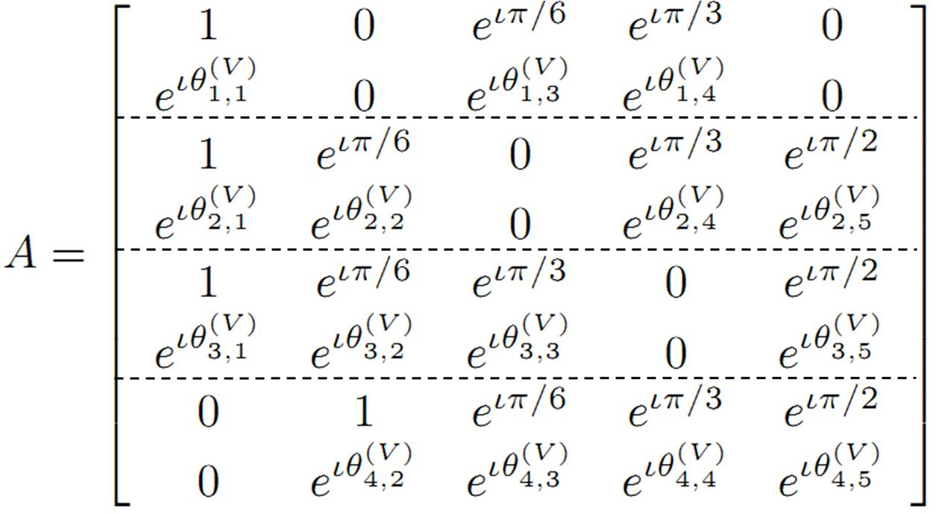
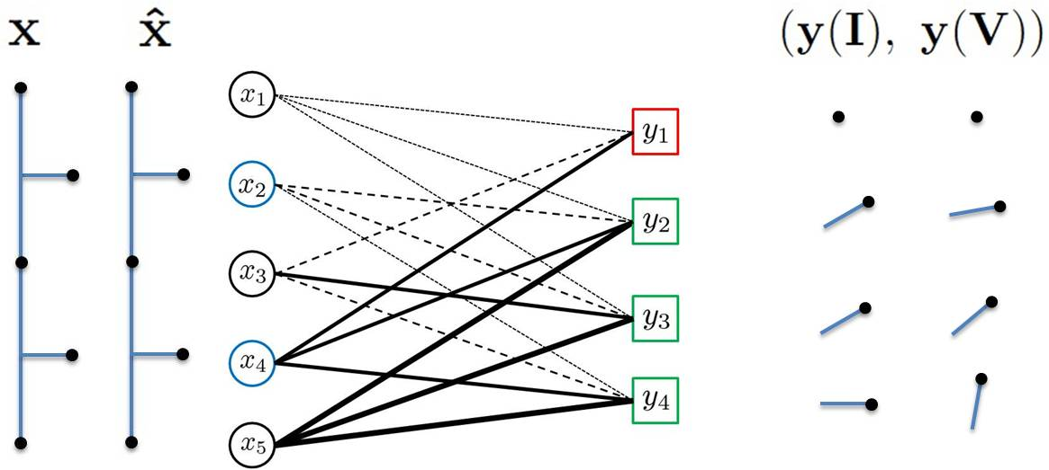
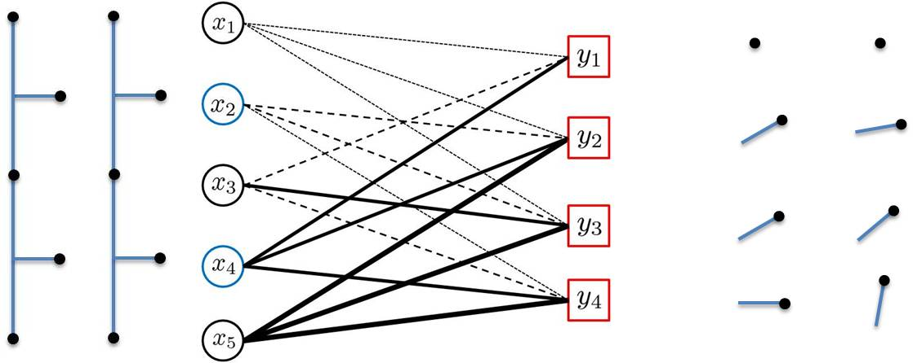
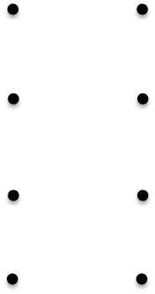
Decoding – Step 4 (4-Passed/STOP)

Slide 36
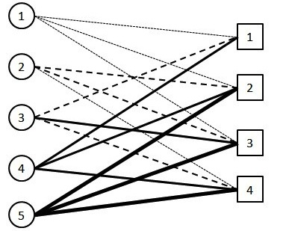
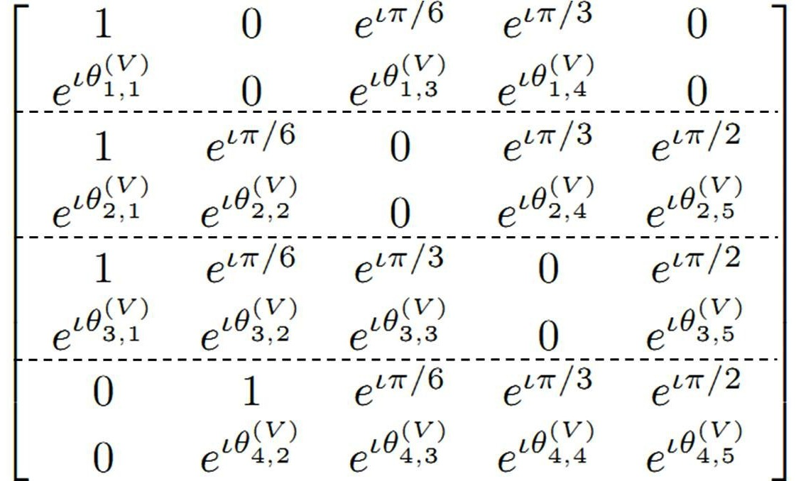
Decoding – Recap.
0
0
0
0
0
0
0
0
1
0
?
?
?

Slide 37
Decoding – Recap.
0
1
0
1
0

Slide 38


Slide 39

Noise/approx. sparsity

Slide 40

Meas/phase error

Slide 41

Correlated phase meas.

Slide 42

Correlated phase meas.

Slide 43

Correlated phase meas.

Slide 44


Network Tomography
Goal: Infer network characteristics (edge or node delay)
Difficulties:
  Edge-by-edge (or node-by node) monitoring too slow
  Inaccessible nodes

Slide 45
Network Tomography
Goal: Infer network characteristics (edge or node delay)
Difficulties:
  Edge-by-edge (or node-by node) monitoring too slow
  Inaccessible nodes
Network Tomography:
  with very few end-to-end measurements
  quickly
  for arbitrary network topology

Slide 46
B. Network Tomography
Transform T:
  Network connectivity matrix
  (known a priori)
Measurements y:
  End-to-end packet delays
Infer x:
  Link/node congestion
Hopefully “k-sparse”
Our algorithm: FRANTIC
Compressive sensing?
Challenge:
  Matrix T “fixed”
  Can only take “some”
  types of measurements
Fast Reference-based Algorithm for Network Tomography vIa Compressive sensing
Idea:
  “Mimic” random matrix

Slide 47


Slide 48
A Better TOMORROW
fast TOMOgRaphy oveR netwOrks
with feW probes

Slide 49
SHO-FA
d=3
A
n
ck

Slide 50
1. Integer valued CS [BJCC12] “SHO-FA-INT”
T

Slide 51
2. Better mimicking of desired T

Slide 52
Node delay estimation

Slide 53

Node delay estimation

Slide 54
Node delay estimation

Slide 55
Edge delay estimation

Slide 56

Idea 1: Cancellation
,
,

Slide 57

Idea 2: “Loopy” measurements
,
Fewer measurements
Arbitrary packet injection/
  reception
Not just 0/1 matrices (SHO-FA)

Slide 59

SHO-FA +
Cancellations +
Loopy measurements
Parameters
  n = |V| or |E|
  M = “loopiness”
  k = sparsity
Results
  Measurements: O(k log(n)/log(M))
  Decoding time: O(k log(n)/log(M))
  General graphs, node/edge delay estimation
Path delay: O(MDn/k)

Slide 60

SHO-FA +
Cancellations +
Loopy measurements
Parameters
  n = |V| or |E|
  M = “loopiness”
  k = sparsity
Results
  Measurements: O(k log(n)/log(M))
  Decoding time: O(k log(n)/log(M))
  General graphs, node/edge delay estimation
Path delay: O(MD’n/k) (Steiner/”Average Steiner” trees)

Slide 61
SHO-FA +
Cancellations +
Loopy measurements
Parameters
  n = |V| or |E|
  M = “loopiness”
  k = sparsity
Results
  Measurements: O(k log(n)/log(M))
  Decoding time: O(k log(n)/log(M))
  General graphs, node/edge delay estimation
Path delay: ??? (Graph decompositions)

Slide 62
C. GROTESQUE: Noisy GROup TESting (QUick and Efficient)

Slide 63
n-d
q
d
1
0
q
0
1
For Pr(error)< ε , Lower bound:
What’s known
…[CCJS11]
Noisy Combinatorial OMP:
Notes:
Malioutov only analyze noiseless case and assume M to be disjunct

Slide 64

This work
# Tests
Lower
bound
Adaptive
Non-Adaptive
◉
[NPR12]
O(poly(D)log(N)),O(D²log(N))
◉
◉
2-Stage Adaptive
O(DN),O(Dlog(N))
◉
◉
Lower bound
Decoding
complexity

Slide 65

This work
# Tests
◉
◉
◉
Decoding
complexity

Slide 66


Hammer: GROTESQUE testing

Slide 67









Multiplicity
?

Slide 68





Localization
Noiseless:
Noisy:
?

Slide 69

Nail: “Good” Partioning
n items
d defectives
GROTESQUE

Slide 70

Adaptive Group Testing
  O(n/d)

Slide 71
Adaptive Group Testing
GROTESQUE
GROTESQUE
O(dlog(n)) time, tests, constant fraction recovered
GROTESQUE
GROTESQUE
  O(n/d)

Slide 72

Adaptive Group Testing
  Each stage constant fraction recovered
  # tests, time decaying geometrically

Slide 73
Adaptive Group Testing
  T=O(logD)

Slide 74

Non-Adaptive Group Testing
  O(Dlog(D))
  Constant fraction “good”

Slide 75
Non-Adaptive Group Testing
  Iterative Decoding

Slide 76

2-Stage Adaptive Group Testing
  =D²

Slide 77
2-Stage Adaptive Group Testing
  =D²
  O(Dlog(D)log(D²)) tests, time

Slide 78
2-Stage Adaptive Group Testing
  =D²
  O(Dlog(D)log(D²)) tests, time
  No defectives share the same “birthday” when S=poly(D)

Slide 79
2-Stage Adaptive Group Testing
  =D²
  O(Dlog(N)) tests, time

Slide 80


Slide 81
Network Tomography
Observation:
  only few edges (or nodes) “unknown”
  => sparse recovery problem

Slide 82

Compressive Sensing
?
m
?
n
Random
k
k ≤ m<n
Notes:
Compressive sensing tell us that if the high dimensional signal is k-sparse which means k entries of x are non-zero, we can use low dimensional linear measurements to do the reconstruction.
There two tasks of cs: the first is how to design sensing matrix or measurements matrix. The second is given measurements and sensing matrix, how to do the decoding.

Slide 83


Network Tomography as a Compressive sensing Problem
End-to-end delay
Edge delay

Slide 84


Network Tomography as a Compressive sensing Problem
End-to-end delay
Node delay

Slide 85
Network Tomography as a Compressive sensing Problem
  Fixed network topology
Random measurements
End-to-end delay
Node delay

Slide 86





Faster
Higher
Stronger

Slide 87
1. Better CS [BJCC12] “SHO(rt)-FA(st)”
# of measurements
Lower bound
°CM’06
°GSTV’06
°SBB’06
°TG’07
°C’08
°IR’08
Lower bound
Our work
°RS’60
◉
°MV’12,KP’12
°DJM’11
Decoding complexity

Slide 88
SHO(rt)-FA(st)
Good
Bad
O(k) measurements,
O(k) time
Good
Bad

Slide 89




High-Level Overview
A
3
3
4
4
4
4
ck
n
ck
n
k=2
k=2
Notes:
Frist, I’d like to show you the sketch of our iterative decoding process.
We generate sensing matrix by bipartite graph, put n entries of x on the left hand side and m=ck measurement nodes on the right hand side. currently just treat it as a black box.
There are three types of measurement nodes.
In each iteration, we utilize the leaf node to estimate one non-zero entry, where leaf node mean the measurement node which connects to only one non-zero entry.
In this example, x2 and x4 are non-zero. Y1 and y3 are a leaf node. In the first iteration, we pick y1 to decode x4
After decode x4, we remove the edges coming out from x4 and pick a new leaf node in the second iteration for example, y4 to decode x2.

Slide 90

High-Level Overview
How to guarantee the existence of leaf node
How to find the leaf nodes and
utilize the leaf nodes to do decoding
3
3
4
4
4
n
ck
k=2
Notes:
You may ask how to identify non-zero entry by a leaf node? How to show the existence of leaf nodes and how to find a leaf node and do the decoding.

Slide 91
Bipartite Graph → Sensing Matrix
d=3
Distinct weights
A
n
ck
Notes:
As mentioned, we generate our sensing matrix by a bipartite graph. In fact, it’s left-regular graph. The left degree could be any constant larger than or equal to 3.
If two nodes are connected, then the corresponding entry of sensing matrix is non-zero. In our design, the non-zero entry is complex number with unit magnitude.
For each measurement node, the edges connected to it have different weights which mean the different phases. Here, we can see that different types of lines represent different phases which are restricted to pi by 2 pi by 3 pi by 6 and 0.

Slide 92


Bipartite Graph → Sensing Matrix
d=3
Distinct weights
A
n
ck
“sparse & random” matrix
Notes:
The forth row of sensing matrix corresponds to the measurement node y4.

Slide 93
Sensing Matrix→ Measurement Design
Notes:
The forth row of sensing matrix corresponds to the measurement node y4.

Slide 94
2. Better mimicking of desired A

Slide 95
Node delay estimation

Slide 96
Node delay estimation

Slide 97
Node delay estimation
Problems
  General graph
  Inaccessible nodes
  Edge delay estimation

Slide 98
Edge delay estimation

Slide 99
Idea 1: Cancellation
,
,

Slide 100
Idea 2: “Loopy” measurements
,
Fewer measurements
Even if there exists inaccessible node (e.g. v₃)
Go beyond 0/1 matrices (sho-fa)

Slide 101
SHO-FA +
Cancellations +
Loopy measurements
Parameters
  n = |V| or |E|
  M = “loopiness”
  k = sparsity
Results
  Measurements: O(k log(n)/log(M))
  Decoding time: O(k log(n)/log(M))
  General graphs, node/edge delay estimation
Path delay: O(MDn/k)
Path delay: O(MD’n/k) (Steiner trees)
Path delay: O(MD’’n/k) (“Average” Steiner trees)
Path delay: ??? (Graph decompositions)

Slide 102
D. Threshold Group Testing
n items
d defectives
Each test:
Probability that Output is positive
# defective items in a group
Goal: find all d defectives
Our result: tests suffice; Previous best algorithms:

Slide 103
Summary
  Fast and Robust Sparse Recovery algorithms
  Compressive sensing: Order optimal complexity, # of measurements
  Network Tomography: Nearly optimal complexity, # of measurements
  Group Testing: Optimal complexity, nearly optimal # of tests
    - Threshold Group Testing: Nearly optimal # of tests

Slide 104
Thank you
謝謝

